Slide 4
Lincoln’s head but, John Calhoun’s body

Slide 5
Cottingley Fairies

Slide 7
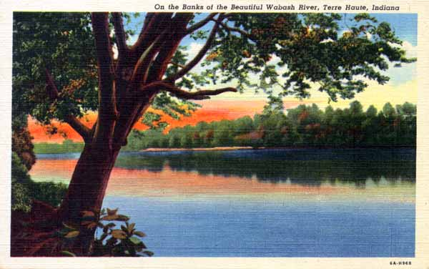
OA-H968 [1930] Wabash Valley News Agency Inc., Terre Haute, Ind.
6A-H968 A. A. Arnold, Vincennes, Ind.
Both cards printed by Curteich, Chicago

Slide 8
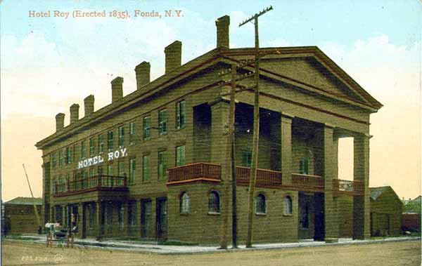
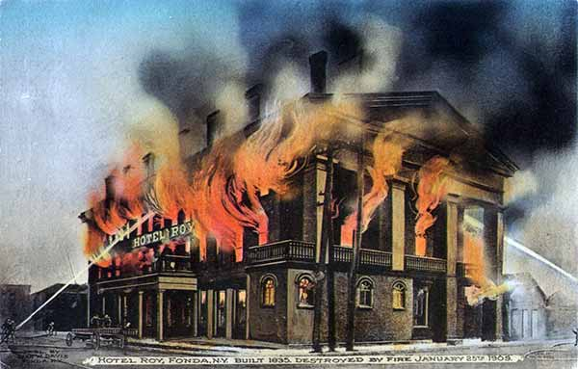
Hotel Roy, Fonda, N. Y.
Built: 1836
Destroyed by fire: January 25, 1909

Slide 9
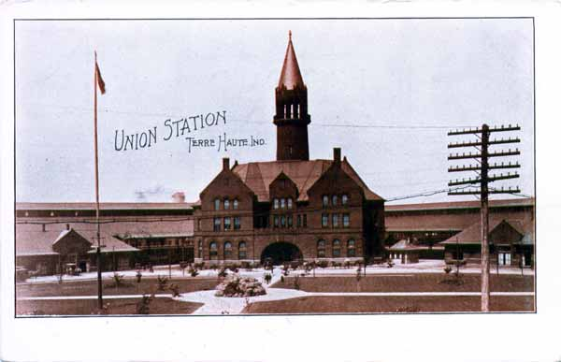
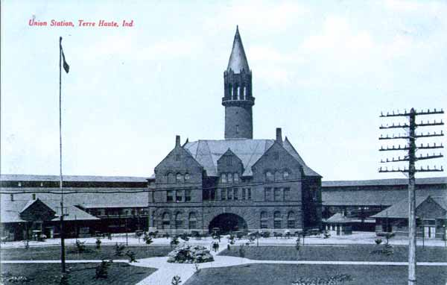
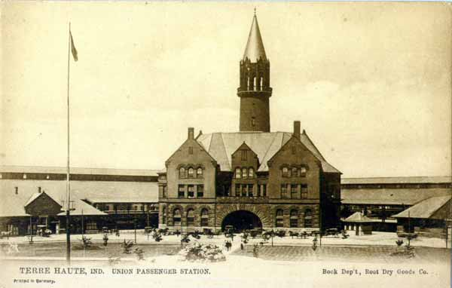
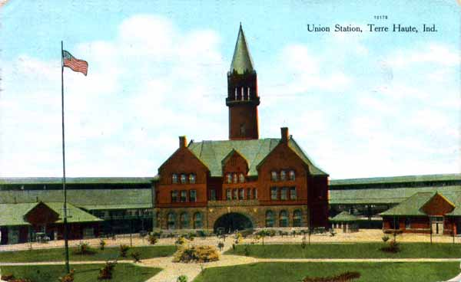
Union Station, Terre Haute

Slide 10
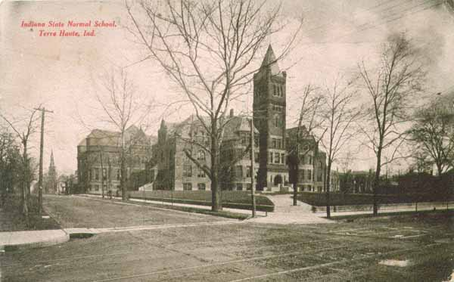
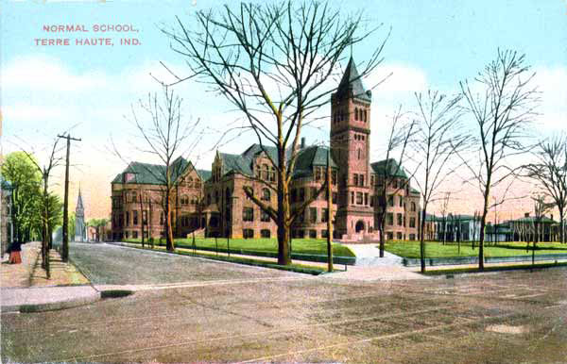
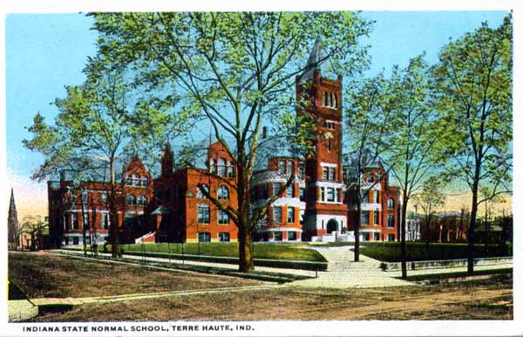
Indiana State Normal School, Terre Haute

